Slide 1
Understanding Economic Growth in India
Author(s): Pulapre Balakrishnan and M. Parameswaran

Slide 2

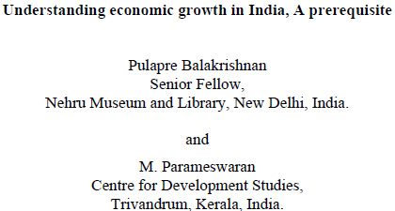
Core Paper Overview
Objective & Scope
Identify distinct phases of macroeconomic growth since 1950.
Avoid arbitrary policy dates (like the 1991 liberalization) to find the true turning points.
Decompose growth to test the hypothesis that the transition was primarily services-led.
Original Data: NAS GDP data (1950–51 to 2003–04), constant 1993–94 prices.

Slide 3



Original Methodology & Findings
Structural Break Test
Growth Decomposition
Econometric Regression
Using the Bai-Perron methodology, the authors identified a major structural break in 1978-79, ending the 3.5% "stagnant growth" era.
Data decomposition revealed that the Tertiary (Services) sector contributed the vast majority of the increased economic growth.
OLS/GMM regressions confirmed that only the lagged growth of the Tertiary sector had a statistically significant, positive impact on overall GDP.

Slide 4
Empirical Replication: Data & Variables
To replicate the study, I extracted modern MOSPI Back-series data (GVA at constant 2011-12 prices) matching the 1950 to 2004 timeframe.
Variable Aggregation
Mathematical Transformation
Primary (Pt): Agriculture, Forestry, Fishing, Mining & Quarrying.
All aggregated sectoral-series were converted into annual percentage growth rates via log-differencing.
Secondary (St): Manufacturing, Construction, Electricity/Gas/Water.
This normalizes the data for time-series analysis and measures continuous compounding.
Tertiary (Tt): Trade, Transport, Financial Services, Real Estate, Public Admin, etc.

Slide 5

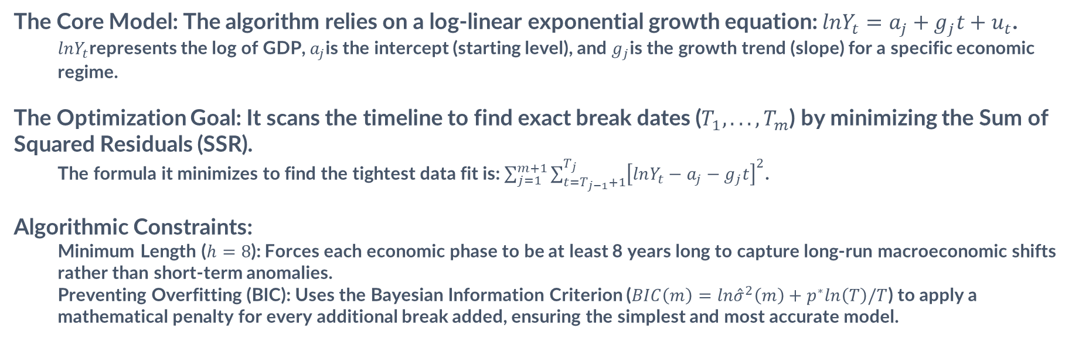
The Bai-Perron Methodology
The Core Model: The algorithm relies on a log-linear exponential growth equation: $lnY_{t}=a_{j}+g_{j}t+u_{t}$.
  $lnY_{t}$represents the log of GDP, $a_{j}$is the intercept (starting level), and $g_{j}$is the growth trend (slope) for a specific economic regime.
The Optimization Goal: It scans the timeline to find exact break dates ($T_{1},...,T_{m}$) by minimizing the Sum of Squared Residuals (SSR).
  The formula it minimizes to find the tightest data fit is: $\sum_{j=1}^{m+1}{\sum_{t=T_{j−1}+1}^{T_{j}}{{\left[lnY_{t}−a_{j}−g_{j}t\right]}^{2}}}$.
Algorithmic Constraints:
  Minimum Length ($h=8$): Forces each economic phase to be at least 8 years long to capture long-run macroeconomic shifts rather than short-term anomalies.
  Preventing Overfitting (BIC): Uses the Bayesian Information Criterion ($BIC\left(m\right)=ln{\overset{ˆ}{σ}}^{2}\left(m\right)+p^{∗}ln\left(T\right)/T$) to apply a mathematical penalty for every additional break added, ensuring the simplest and most accurate model.

Slide 6
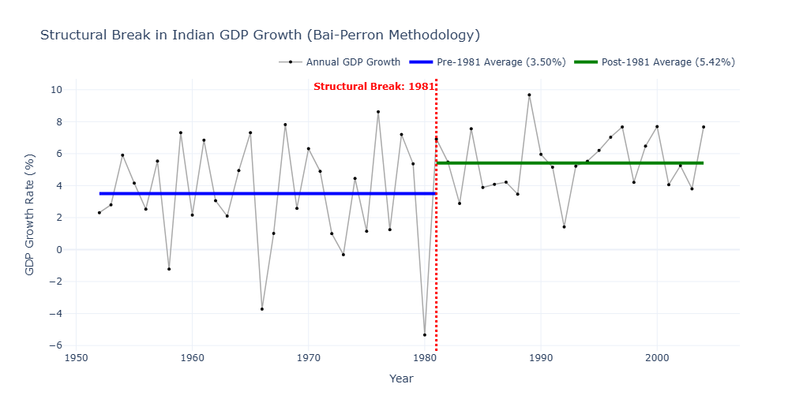
Structural Break Analysis
Bai-Perron Dynamic Programming
Applying the Bai-Perron algorithm with a strict minimum segment constraint of 8 years (h=8) successfully identified a definitive structural break in 1981.
Pre-1981: Slow Growth Rate
Post-1981: Accelerated Expansion
Characterized by a stagnant macroeconomic environment, the Indian economy experienced a sluggish historical growth trend.
A definitive structural break shifted the economy into a high-gear trajectory, independently establishing a new growth baseline.
3.50% Average Growth
5.29% Average Growth

Slide 7
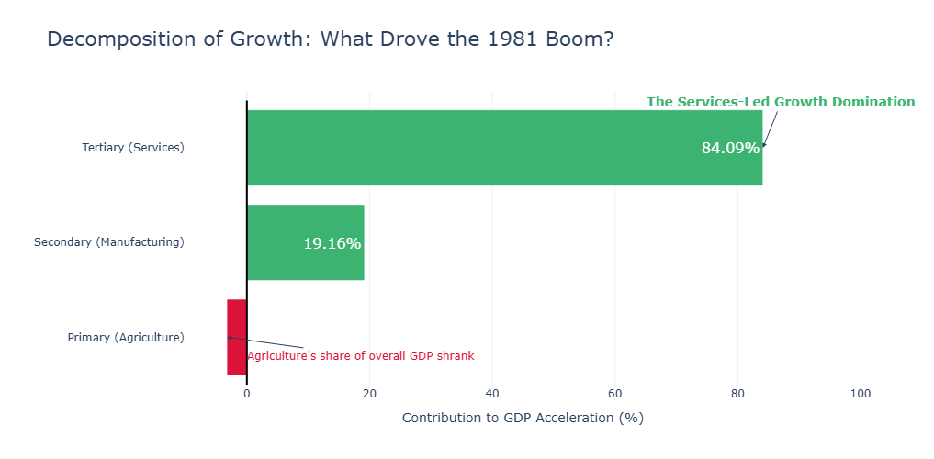
Phase 2: Sectoral Decomposition Analysis
A shift-share decomposition across the 1981 threshold determines exactly where the accelerated growth originated.
The Services Domination
The mathematical outcome confirms the original question: The Tertiary sector accounted for a massive 84% of the aggregate growth acceleration, dominating the economic transition.

Slide 8
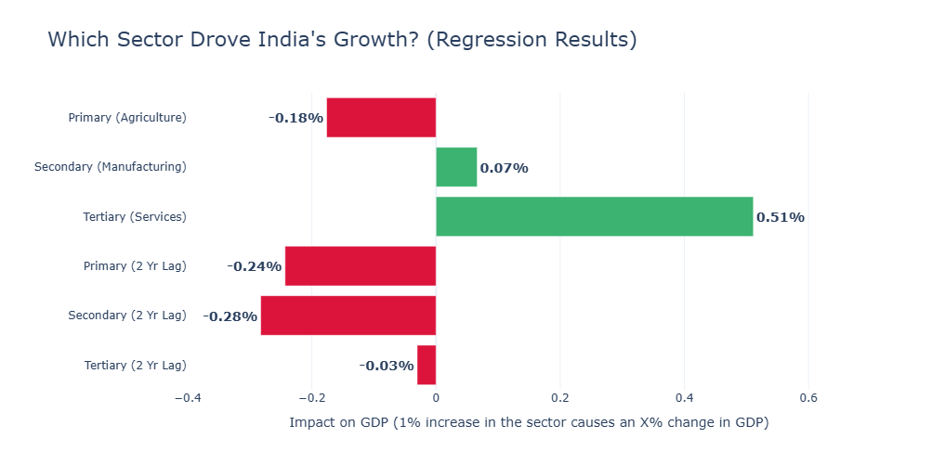
Econometric Regression
Testing Sectoral Causality
An Ordinary Least Squares (OLS) model was estimated, regressing current aggregate GDP growth on lagged sector growth rates.
Tertiary Sector Coefficient (β) = 0.5111
The regression confirms that the lagged Tertiary sector represents the sole positive sectoral driver, overriding manufacturing-led theories of growth.

Slide 9



The Data Vintage Effect
Comparing the replication with the original 2007 paper reveals critical methodological insights regarding macroeconomic data revisions.
Original Study (1993-94 Base)
Replication (2011-12 Base)
Core Consensus Validated
Utilizing the older 1993-94 constant prices, the algorithm originally located the structural break in 1978-79.
Applying the algorithm on updated, modernized 2011-12 constant price series shifts the exact inflection point slightly to 1981.
Despite the slight year shift, both datasets prove the transition initiated in the late-1970s/early-1980s, independent of 1991 reforms.

Slide 10

Conclusion
Services-Led Trajectory Validated
The empirical replication validates the central hypothesis: the acceleration of the Indian economy was definitively services-led.
The regime shift in 1981 confirms the transition occurred a full decade prior to the 1991 liberalization.
Both shift-share decomposition (84.09% contribution) and OLS regressions mathematically prove that acknowledging the 1980s services boom is a prerequisite to understanding India's trajectory.

Slide 11
Sources
Core Paper: Understanding economic growth in India_A prerequisite_Economic.pdf
Dataset used: STATEMENT 3.2 GROSS VALUE ADDED BY ECONOMIC ACTIVITY (CONSTANT (2011-12) PRICES)
Python notebook: Indian_Eco_Paper_Replication.ipynb; Google Colab Notebook

Slide 12
THANK YOU

